Slide 1
Tutorial: Convolutional Neural Networks
By
Apaar Shanker
Matthew Barry

Slide 2
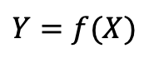
The Supervised Learning Universe
vector values
Discrete labels
Continuous scaler values
$$Y=f(X)$$
sequential
Continuous vector values
spatial
Approximating Techniques
Linear regression/ Logistic regression
Support Vector Machines
Decision Trees
Neural Networks
Convolutional Neural Networks
Recurrent Neural Networks

Slide 3
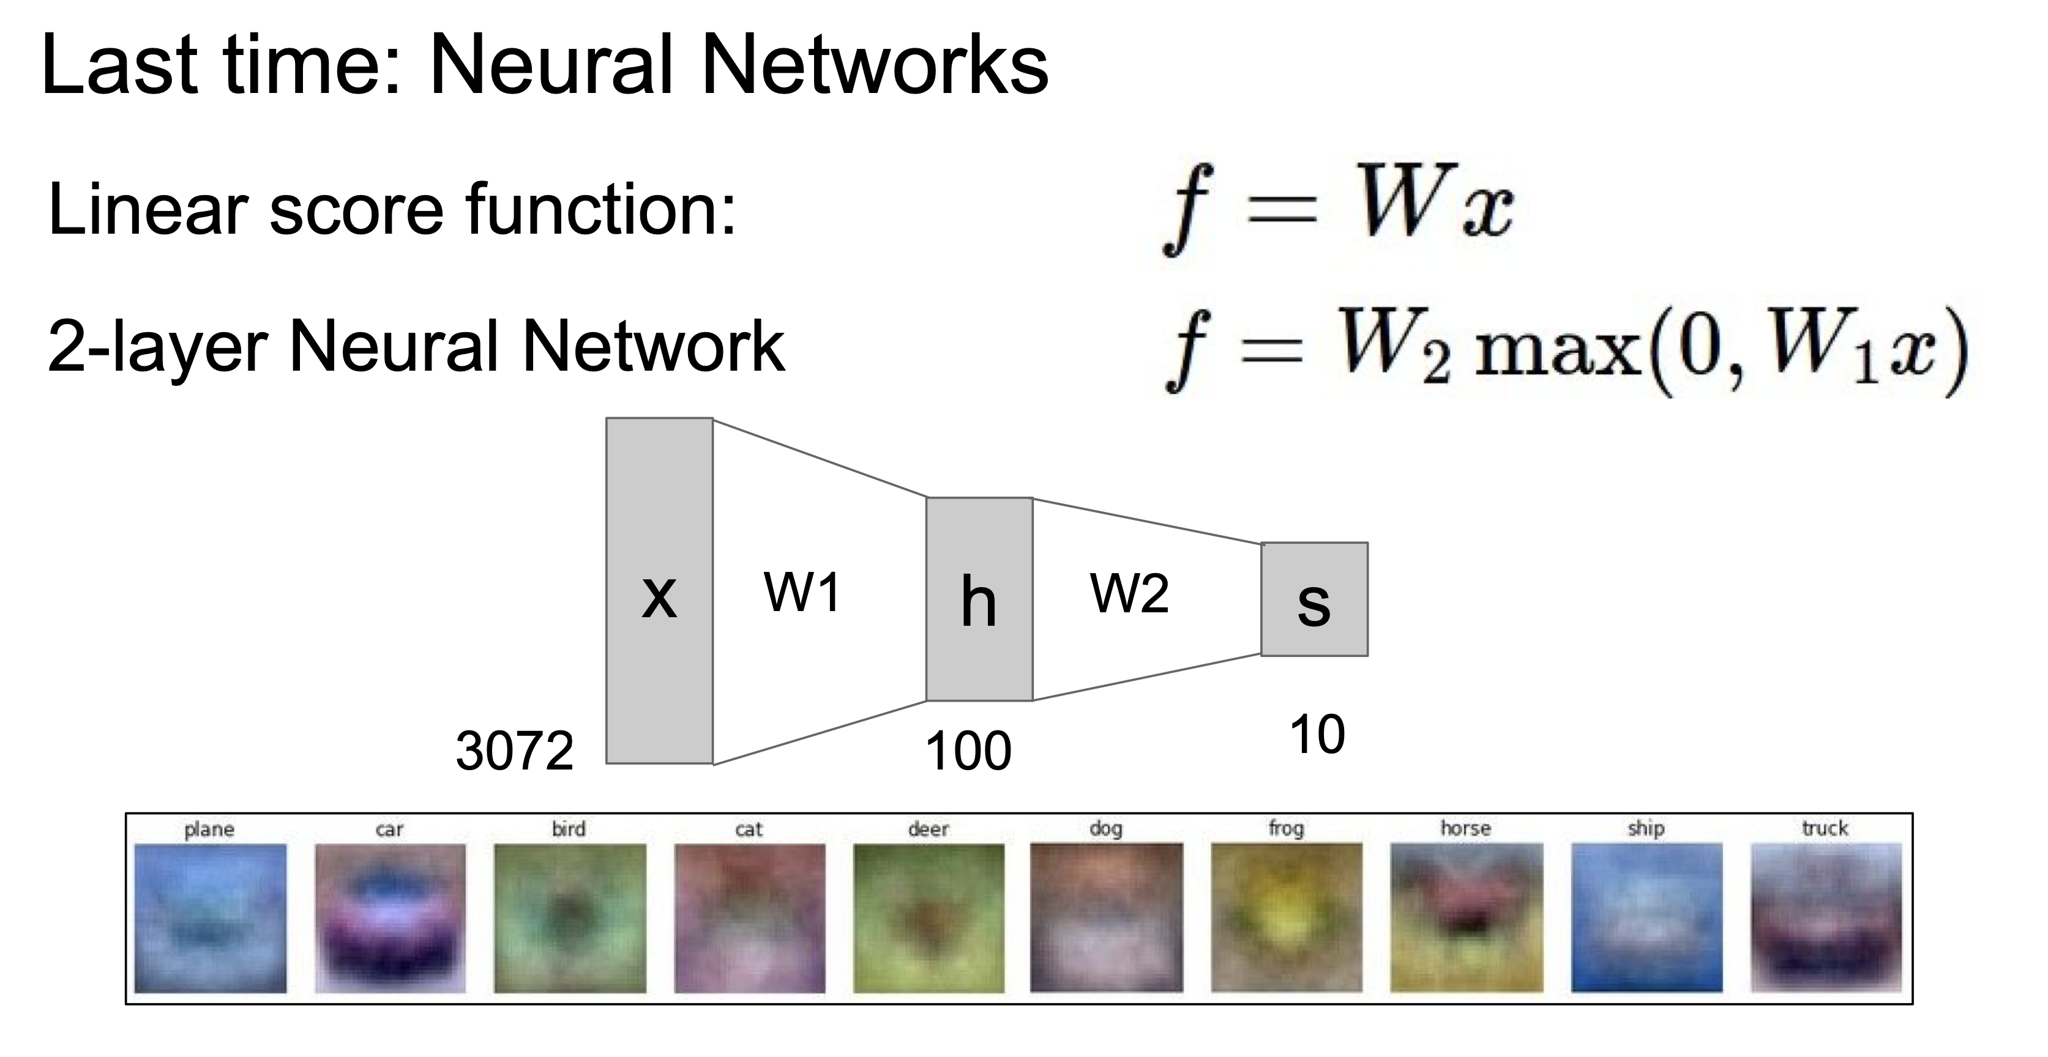
The Supervised Learning Universe

Slide 4
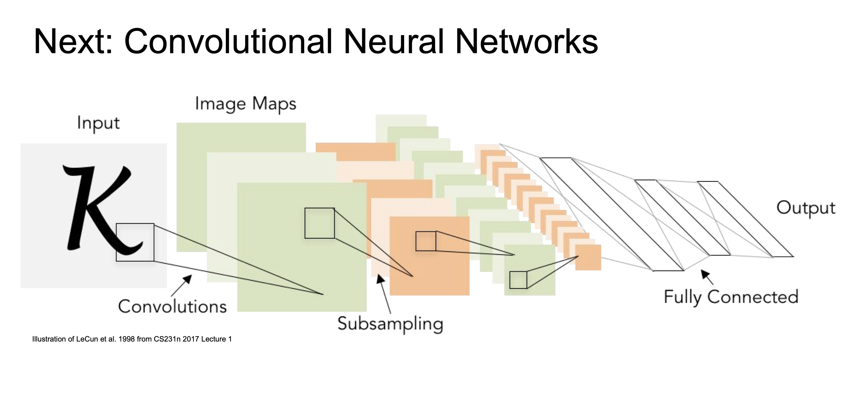

Slide 5
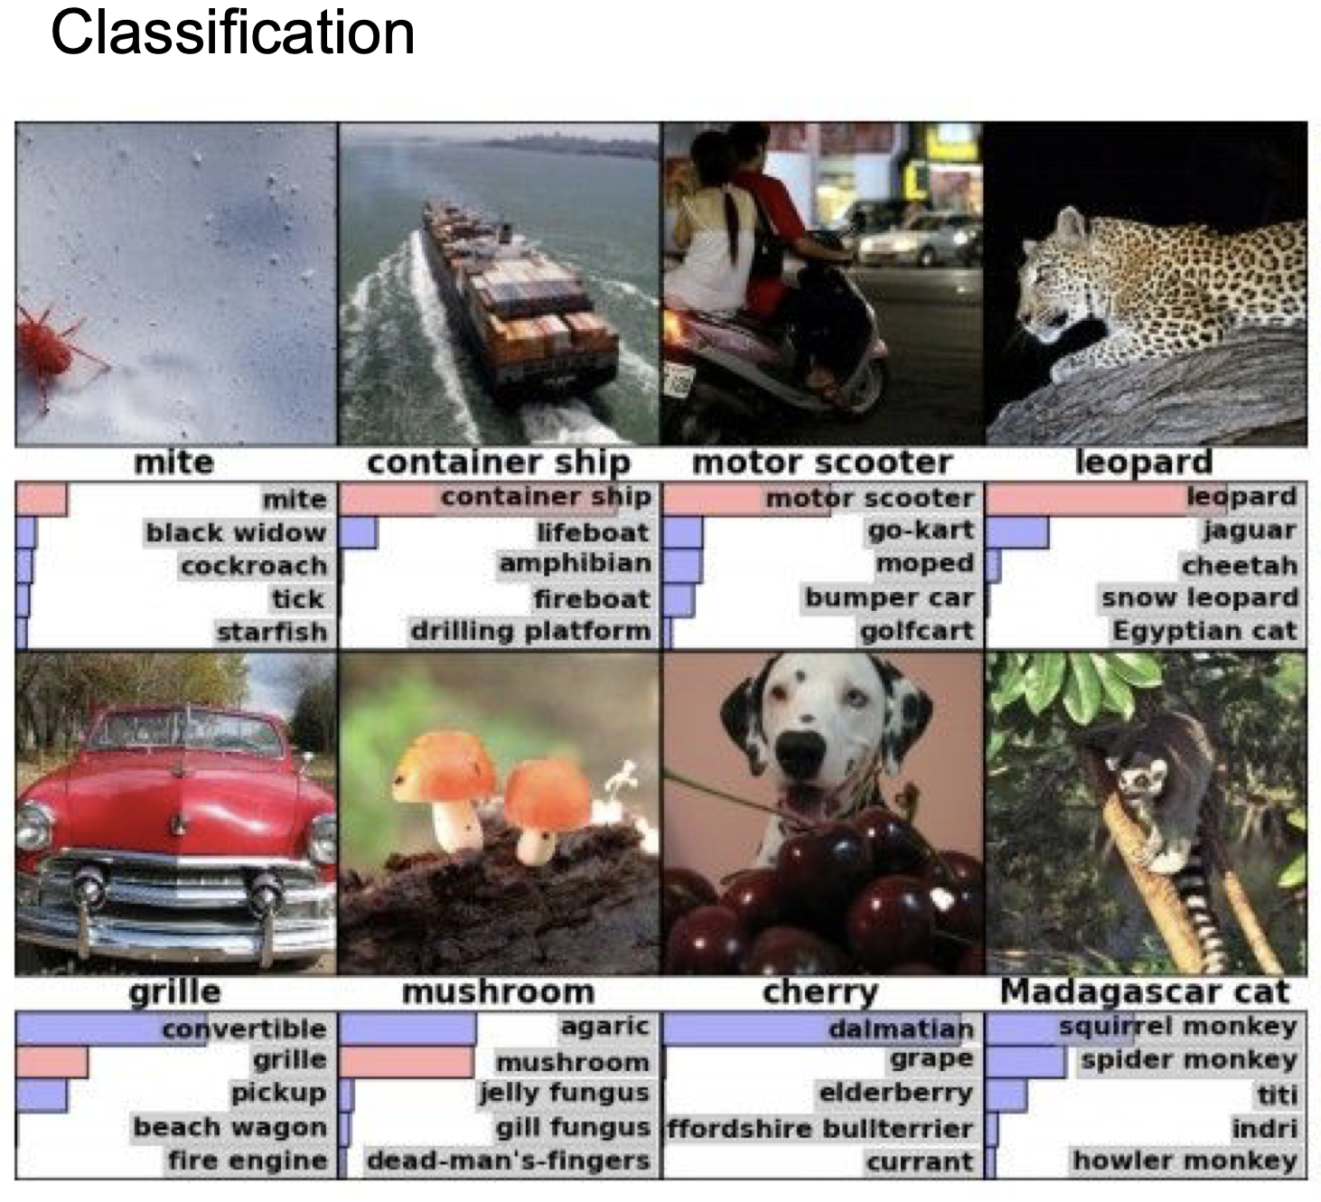
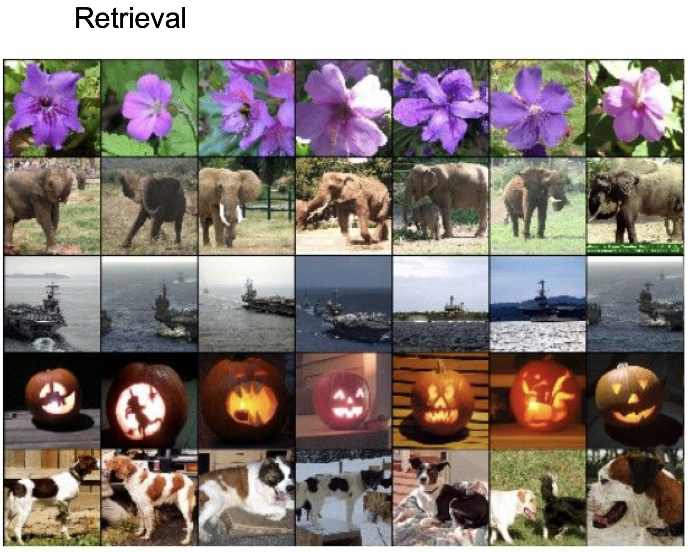
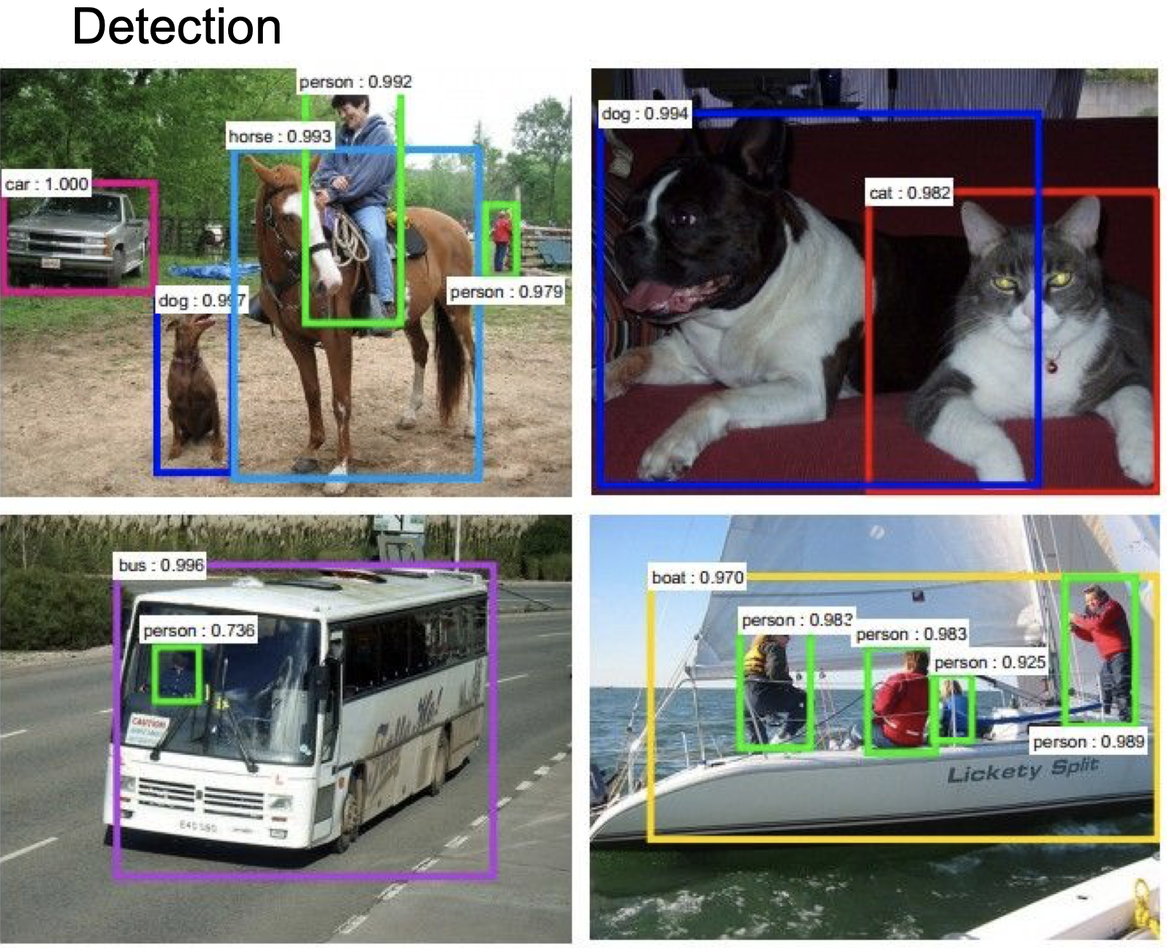
Conv Nets are Every Where

